Slide 1
GE REN Finance DT Cash Automation Web Site

Slide 2
Business problem
There is requirement of a website which will be a one stop platform for all tools and documentation related to cash automation.
Current scenario (without website)
The situation currently is highly human dependent. When a person involved in cash automation needs help, he/she has to either look into box where the documents are not well organised or ask Giuseppe, Wendy or Zoltan. When they are not available, it creates a problem and slows down the process.
Business outcome (link to: CBA&CFI) (link to: Benefits in detail)
1. Instead of referring the box or going after people to seek information, people can focus on right things, speed up the cash automation process and increase productivity. Cost saved on Key Users because of website=8400$/year(approx.)
2. Cycle time gets reduced by 360 hrs/year(approx.), thus speeding up cash collection and application process. Money gets into GE in quicker time. As cash is the most important KPI for any GE project, the website adds great value. Approximation of 17M $ gets into GE as positive cash flow in lesser time of 360 hrs/year.

Slide 3
Options for tech stack
WordPress is the world’s most popular content management system.
WordPress now powers 40% of all websites and controls a massive 40.0% of the known content management system market.
2. Bench is a GE tool for resource sharing.
3. Drupal has been around for even longer than WordPress, though it lacks WordPress’ gaudy market share. Originally launched in 2000, Drupal powers 2.3% of all websites and has a 4.6% share of the content management system market.

Slide 4
Market share of CMS
Copyright © GE 2021. Proprietary. All Rights Reserved.

Slide 5


BENCH
BENEFITS
DRAWBACK
BENCH is a GE tool. It does not involve cost for using it.
User friendly interface.
BENCH is a tool that provides a centralized platform for information sharing. It is like version control system(GIT) where project members can share progress, resources and tools. It is not a software for creating website.
Not visually appealing.
Not as per needs and expectation. When used as a site, looks like amalgamation of several modules.
Non interactive and obsolete environment, doesnot serve our purpose.
Notes:
© Copyright PresentationGO.com – The free PowerPoint and Google Slides template library

Slide 6
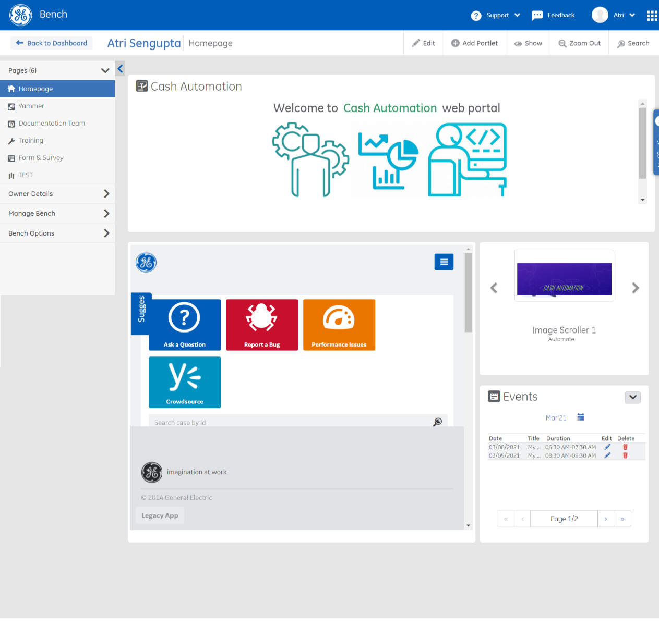
BENCH FOR CASH AUTOMATION
Links for Homepage, Yammer, Documentation, training, Forms and survey, Test. But as you see, the look and feel of it isn’t like a website. It isn’t attractive and not a place that people will come back for ease of use.

Slide 7
DRUPAL
BENEFITS
DRAWBACK
Installation available within GE REN.
Good for web developers.
Only 4% of CMS-based websites and 2% of all websites on web are through DRUPAL.
Charges involved for Domain name, Hosting, SSO integration.
Developer support needed for build, design, deploy.
Interface is not user friendly.
Less customizable options.
Code centric, good for web developers but team consisting of non developers.
Involves steep learning curve, so website cannot be made available in quick time.
Notes:
© Copyright PresentationGO.com – The free PowerPoint and Google Slides template library

Slide 8
WordPress
BENEFITS
DRAWBACK
Domain name, SSO, Hosting solutions available free of recurring charges in WordPress installations within GE.
No maintenance cost.
No technical support needed for design and build.
Visually appealing.
User friendly interface.
Delivery of website in quick time.
WordPress installation not available in GE REN.
Installations are available FREE OF CHARGES for
i. GE Aviation(blogs.aviation.ge.com)
ii. GE Power(https://blogs.gepower.com/)
iii.GE Research.
iv. GE HealthCare.
As written in the aviation platform, URL will be in form of aviation.ge.com. It is strictly for aviation content. Need to have something similar for GE Renewable.
Notes:
© Copyright PresentationGO.com – The free PowerPoint and Google Slides template library

Slide 9
WordPress
Bench
Drupal
Cost
P
O
P
Presentation
10
2
6
Technical support
O
O
P
User friendly
8
8
4
Purpose served
P
O
TBD

Slide 10

DEMO WEBSITE FOR CASH AUTOMATION
The website is made via WordPress. Website is currently in local host. This is a demo version and has tabs of HOME, DOCS, FAQ, CONTACT. The site is interactive and responsive at same time. User friendly and easy to maintain.
At full function, we expect 70-80 people using this. A weekly count of 20 unique people using it, is a considerable success.

Slide 11
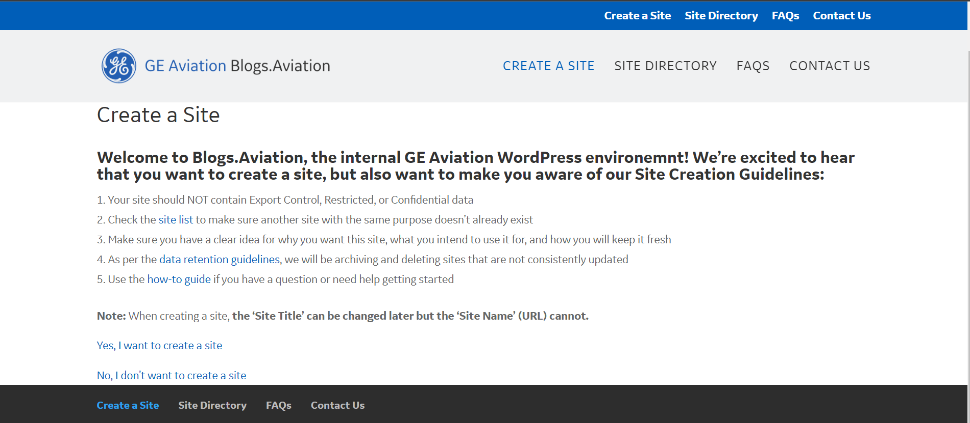
GE AVIATION WordPress installation

Slide 12
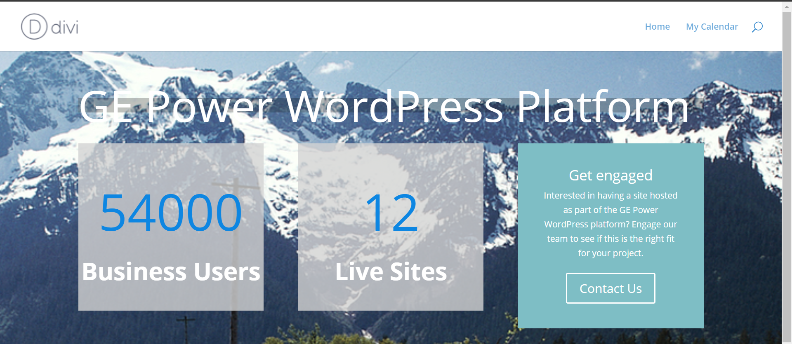
GE POWER WordPress installation

Slide 13
What’s next? Excel sheet for progress and point of contacts established. Contacts and options.xlsx For having installation of WordPress like other GE divisions, which can be used by all teams in GE REN: 1. Need to establish contact to a team of solution architects which deal with cloud platforms (Azure and AWS). 2. Platform is basically 3 prod AWS nodes (a load balancer/ELB and 2 app servers EC2) + an RDS database and an EFS file storage mount for sharing files between the two app nodes. 3. Aviation have a nonprod environment which is basically the same (but only one app node)​. Those details might help your architects determine what cost might be.

